Slide 1



Parameter Fitting:
Overview
Joseph L. Hellerstein^{1,2}
¹eScience Institute
²Department of Computer Science & Engineering
July, 2021

Slide 2
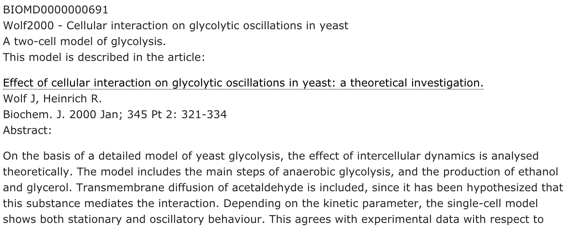
What’s Parameter Fitting? Why important?

Slide 3
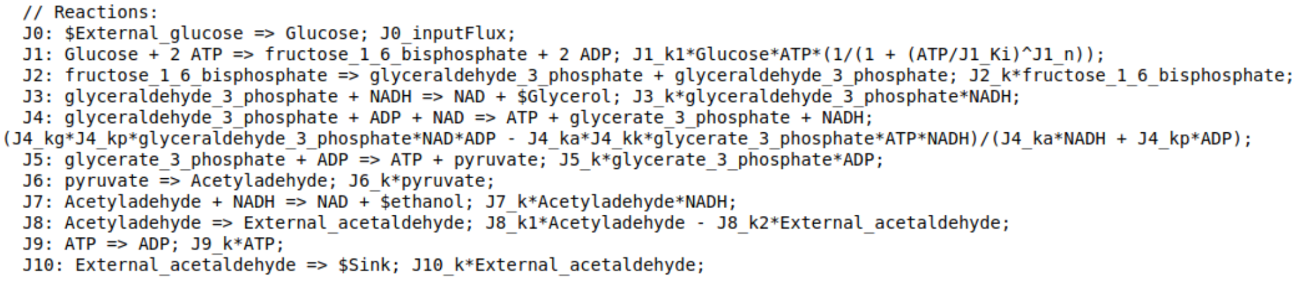
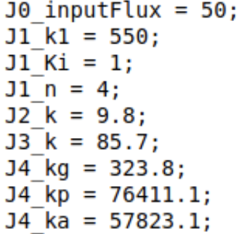
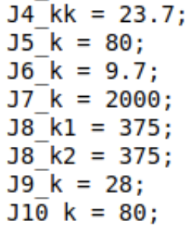
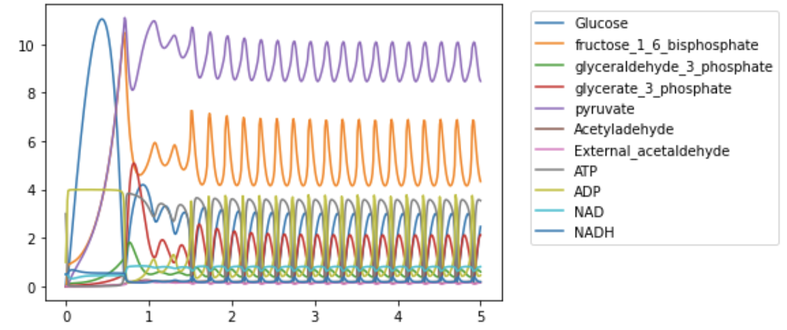
Wolf2000 Model of Glycolytic Oscillations
Model Parameters and their settings in the published work.
Notes:
Emphasize that the parameters permeate the model.

Slide 4
Fitting Basics
Objective
Find values of parameters that make the model fit observed data.
Residuals
Difference between observed values of data (floating species) and simulated values

Slide 5
Generic Algorithm for Kinetic Model Parameter Fitting
Inputs
model: describes time evolution of species concentrations and fluxes based parameters
parametersToEstimate: parameters to be estimated
observedValues: time course values of species concentrations
Outputs
parameterEstimates: a good choice of the values for parametersToEstimate
Steps
do until good estimate or exceed runtime limits
settings = new assignment of values to parametersToEstimate
simulationResults = run model using settings
residuals = observedValues - simulationResults
if the sum of squares of residuals is smaller than previous settings
parameterEstimates = settings
if residuals are very small
return parameterEstimates
search algorithm

Slide 6
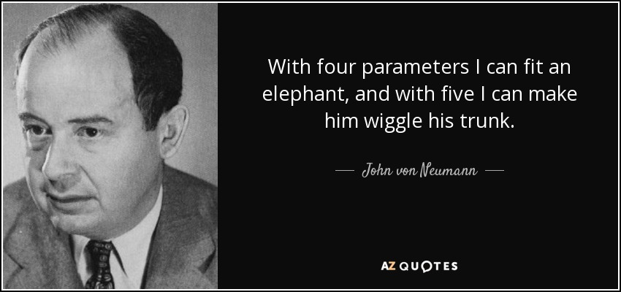
Concern 1: Fitting a large number of parameters to a small dataset.
1903-1957
Models in Systems Biology almost always have many more than five parameters.
Notes:
Some humility about the problem being addressed.

Slide 7
Concern 2: Computational Complexity of Parameter Fitting Using Exhaustive Search
Assume 1 microsecond for a simulation (single assignment of parameter settings).
Calculate log10(# hours) - time to simulate all combinations of parameter settings.
# Parameters
 | 1 | 2 | 4 | 8 | 16 | 32 | 64
2 | -9.3 | -9 | -8.4 | -7.1 | -4.7 | 0.1 | 9.7
4 | -9 | -8.4 | -7.1 | -4.7 | 0.1 | 9.7 | 29
8 | -8.7 | -7.8 | -5.9 | -2.3 | 4.9 | 19.3 | 48.2
16 | -8.4 | -7.1 | -4.7 | 0.1 | 9.7 | 29 | 67.5
32 | -8.1 | -6.5 | -3.5 | 2.5 | 14.5 | 38.6 | 86.8
64 | -7.8 | -5.9 | -2.3 | 4.9 | 19.3 | 48.2 | 106
second | -3.56
hour | 0
day | 1.38
month | 2.86
year | 3.94
century | 5.94
Age of Universe | 14.09
# Settings
(levels)
Notes:
Exhaustive search is a search algorithm that looks at all combinations of parameter settings.

Slide 8
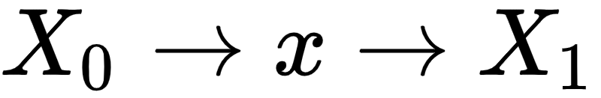
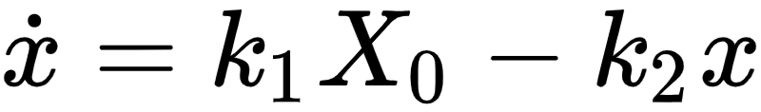
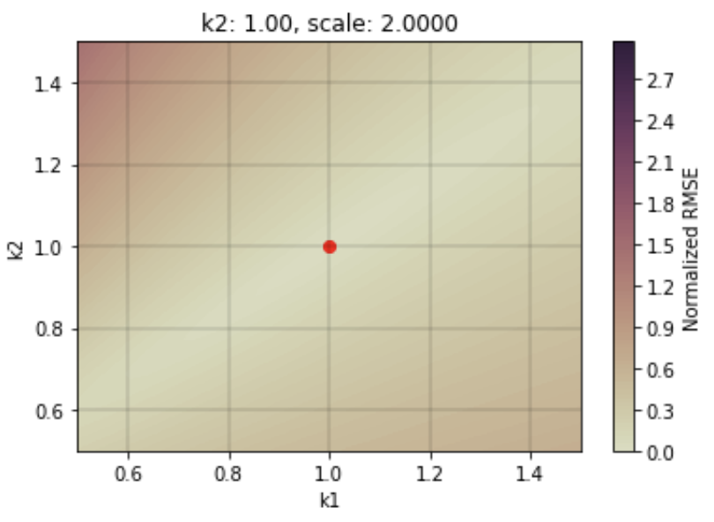
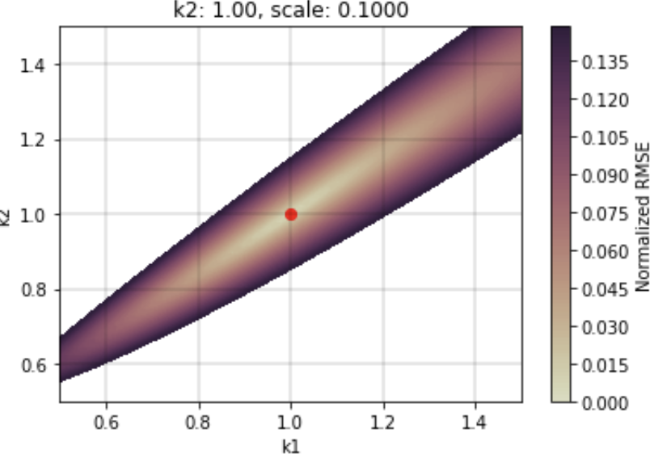
Fitting Surface: 2 Parameters
Fitting Surface: Sum of square of residuals vs. parameter settings.
Residuals = simulation results using the true settings parameters minus the results using other settings.
Convex fitting surface. Gradient descent finds the best fit.
Avoids computational complexity of exhaustive search.
The fitting surface is a “road map” for a search algorithm.

Slide 9
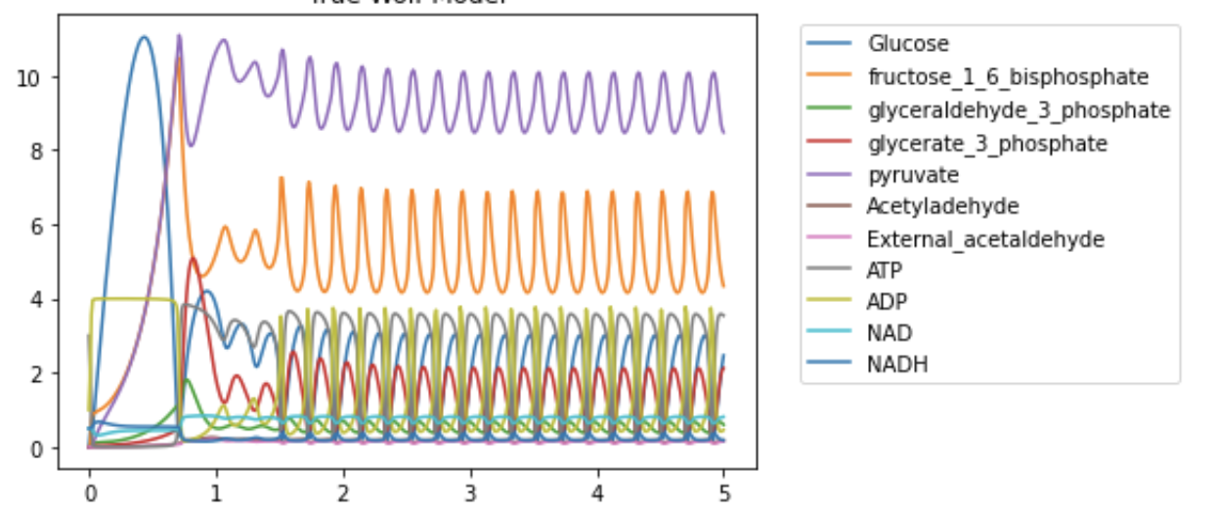
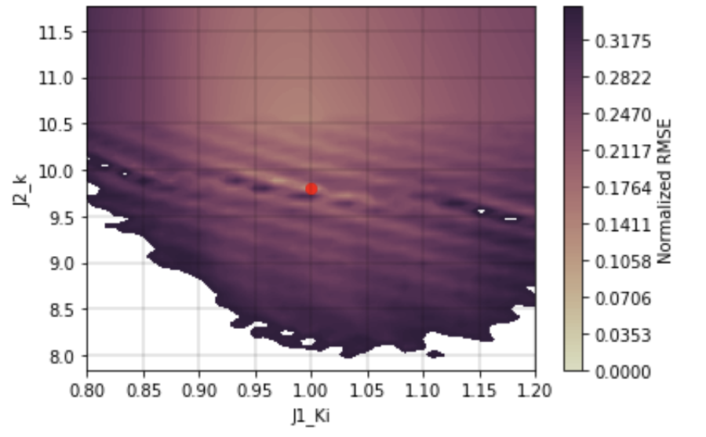
Fitting Surface: Wolf Model
Combinations of J2_k, J1_Ki
Gradient descent can get stuck in ridges.

Slide 10
Factors Affecting Complexity of Fitting
Fitting surface
Convex?, Number of local optima?
Number of parameters
Number of levels of parameters
Starting point for the search
Observational data
Which species are measured?
Variance of measurements?
Identifiability of parameters
2 parameters, 1 species
Glycolytic Oscillations
Parameter fitting is an exploratory data analysis (EDA).
SBstoat is a tool that supports fitting EDA.

